Slide 1
The Catfish Effect
鲶鱼效应
Team members：于一 程序 唐梦婷 刘欣豪

Slide 2
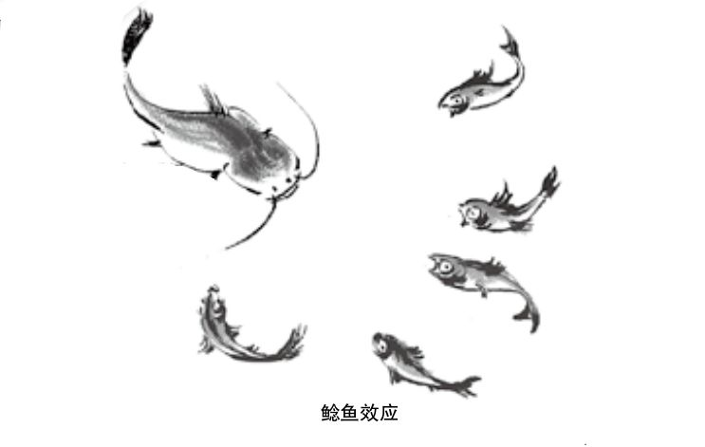
It‘s not just the big fish eating the small fish！

Slide 3
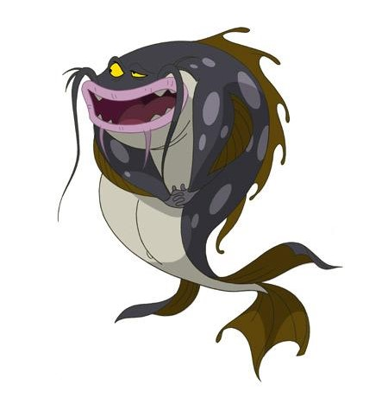
Origin
Norwegians love to eat sardines, especially live fish. The price of live fish in the market is much higher than that of dead fish, so fishermen always try to bring live sardines back to port. Despite all these efforts, most sardines suffocate to death in the middle.
Later, someone put a catfish that fed mainly on fish in the sardine tank. When the sardines saw the catfish running around, their lack of oxygen was solved and most of them returned to the fishing harbor alive and well..

Slide 4
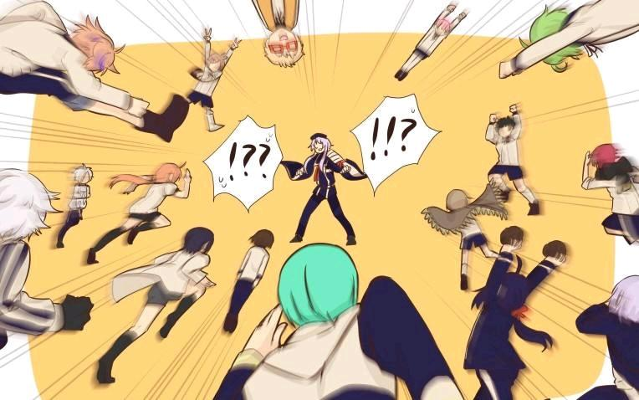
Nowadays
Mainly in Talent development
Introduce a "catfish" to make the team nervous
"Catfish effect" is an effective measure for enterprise managers to stimulate the vitality of employees. Specifically, it refers to that the organization and management departments activate the vitality of the original employees by introducing excellent talents, and produce the agitating effect that a stone stirs up a thousand layers of waves. Returnees often have a very positive "catfish effect" when they return to China.

Slide 5

Nowadays
Tesla
This January marks the one-year anniversary of the opening of Tesla's Shanghai factory. Looking back on the past year, despite the shadow cast by the epidemic, the mainland car market is still vibrant under Tesla's "catfish effect". In addition to the hot sales of domestic Tesla cars, the overall sales of new energy vehicles rose by more than 10% against the trend.

Slide 6

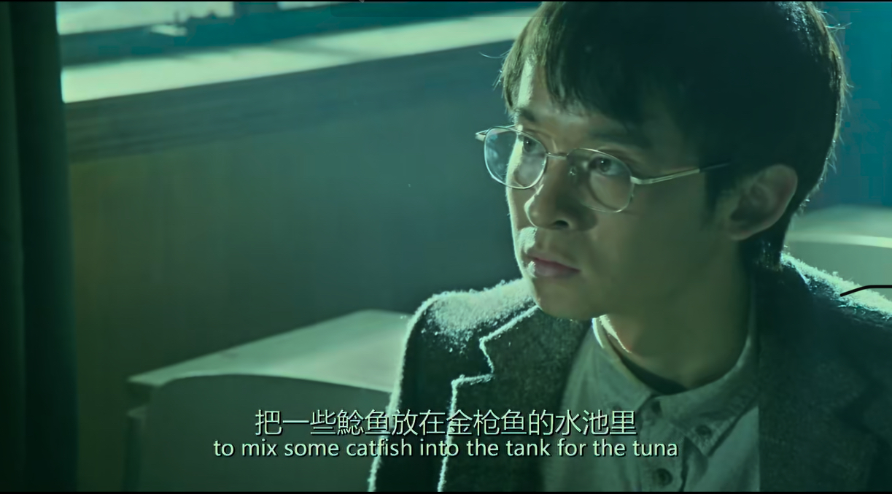
The protagonist, Wu Wei, is a “catfish” among a group of talented teenagers.

Slide 7

What can we do?
1、Keep a sense of crisis
2、Faith
3、Continuous learning

Slide 8
THANK YOU
FOR ATTENTION!

